Slide 1

Providing recreational and competitive rowing opportunities
for both youth and adults in Albany since 1984.

Slide 2
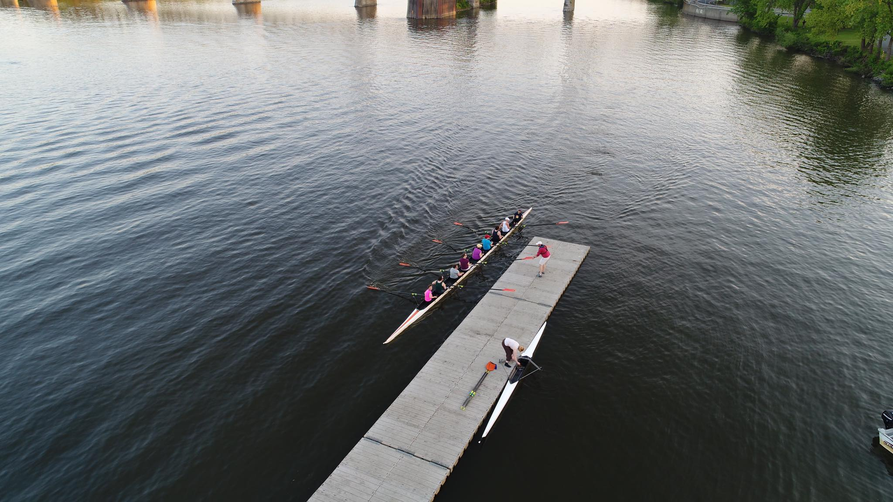
“Coming together is a beginning. Keeping together is progress. Working together is success.”
- Henry Ford
Find value in supporting our hard-working team!

Slide 3

Ice breaker challenge 5K Race
Hosted in Albany since 2011
Marks the start of outdoor rowing and running season!
Average of 280+ participants
Runners challenge rowers from the Albany Rowing Center racing along side in shells on the Hudson River
Course runs along the Corning Preserve Bicycle Path
More than 500 attendees and spectators

Slide 4
Ice Breaker Challenge Sponsorship Opportunities
Race Naming Sponsor: $2,000
1 Available
Full naming rights to the 2023 event!
Listed as naming sponsor on ARC website, Social Media, and all race materials with logo, including race t-shirts
Opportunity to have vendor booth at race and banner/sign of sponsor’s choice at starting line
Promotional materials in race bag
Special PA announcements mentioning sponsor name during and after the race
Four (4) complimentary race entries w/ race t-shirts
Starting Line Sponsor: $800
Multiple Available
Listed as top sponsor on ARC website, Social Media, and all race materials with logo, including race t-shirts
Opportunity to have vendor booth at race and banner/sign of sponsor’s choice at starting line
Promotional materials in race bag
Special PA announcements mentioning sponsor name during and after the race
Two (2) complimentary race entries w/ race t-shirts
Finish Line Sponsor: $800
Multiple Available
Listed as top sponsor on ARC website, Social Media, and all race materials with logo, including race t-shirts
Promotional materials in race bag
Special PA announcements mentioning sponsor name during and after the race
Two (2) complimentary race entries w/ race t-shirts
More on Next Page…

Slide 5
Ice Breaker Challenge Sponsorship Opportunities
Mile Marker Sponsor: $500
3 Available
Listed as sponsor on ARC website, Social Media, and race materials, including race t-shirts
Exclusive Sponsorship of your choice of 1st, 2nd, or 3rd Mile Marker
Two (2) complimentary race entries w/ race t-shirts
Kids Fun Run Sponsor: $400
1 Available
Listed as sponsor on ARC website, Social Media,
and race materials, including race t-shirts
Photo Sponsor: $400
1 Available
Listed as sponsor on ARC website, Social Media,
and race materials, including race t-shirts
General Sponsor: $350
Multiple Available
Listed as sponsor on ARC website, Social Media, and race materials, including race t-shirts
Runner Fuel Support Sponsor: In Kind Donations
Multiple Available
Listed as sponsor on ARC website, Social Media, and race materials, including race t-shirts
Promotional materials in race bag

Slide 6
The Head of the Hudson Regatta
Hosted in Albany since 2005
First regatta of the season!
In 2025 we had 36 rowing clubs from all over the Northeast
Over 150 athletes
More than 300 attendees
37 different races across all adult and youth events

Slide 7
Head of the Hudson Sponsorship Opportunities
Naming Sponsorship: $3,000
Company name precedes regatta name on promotional materials.
Ex: Company XYZ presents the Head of the Hudson Regatta
General Sponsorship: $500
Banner logo
T-shirt logo
Website logo
Social media mentions
Add on items:
These are in addition to your General Sponsorship and include preferred placement of the General Sponsorship items.
Safety Sponsor: $500
Help ensure the safety of our athletes!
Sign at launch
Megaphone mentions
Timing Sponsor: $500
Help ensure accurate and fair recording of all events!
Sign at results board
Megaphone mentions
Food Tent: In-kind donations
Keep the athletes and supporters energized!
Sign at food tent
Distribute promotional items
Welcome Announcements: $500
Start the event off with your brand!
Address the full crowd before first race starts
Fun Sponsor: $300
Make sure everyone has a great time at the regatta!
Distribute promotional items
Interact with attendees

